Slide 1
Managing Microsoft Azure
Use the Azure portals.
Use Azure Resource Manager features via the Azure portal.
Use Azure PowerShell.

Slide 2
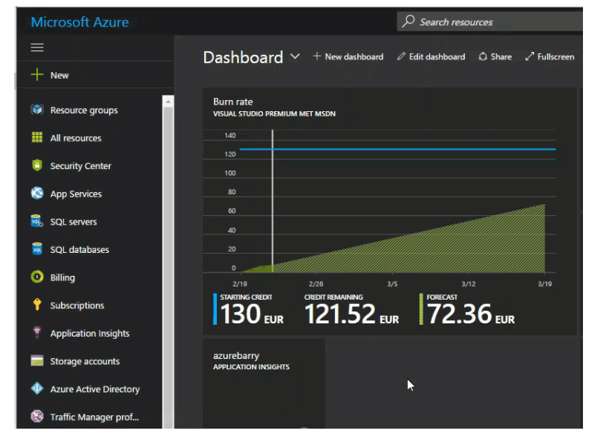
Use the Azure portals.
The Azure Portal is the go-to place to manage your Azure resources. I spend a lot of time in the portal. I’m sure a lot of you do the same. Here are some tips that will hopefully help you to make the most out of your time in the Azure portal.
1. Change Themes
Double-click on any open space on the dashboard in the portal to change the theme.

Slide 3
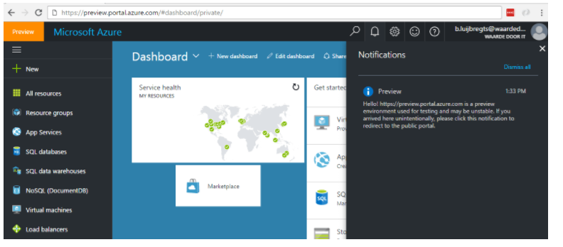
2. Preview of the Azure Portal
A preview of what!!??! Are they changing the Azure portal again? No, not
really. Microsoft is just continually improving the current Azure portal. You
can access a preview of what Microsoft is building
at https://preview.portal.azure.com/. This version of the portal changes often.
Use it at your own risk, as some features might be unstable (it is a preview
version, after all).

Slide 4
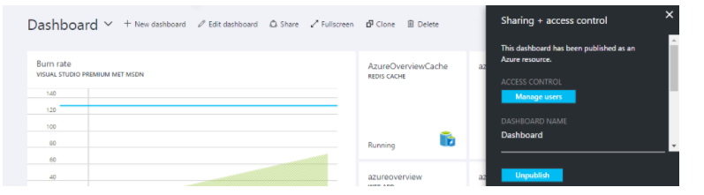
3. Dashboards
The dashboard on the main page of the portal is fully customizable. You can
change and add items on it to completely make it your own. You
probably knew that already. But did you know that you could create more
dashboards?

Slide 5
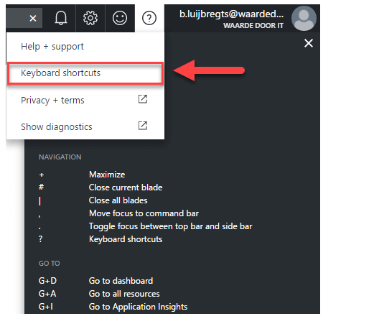
4. Keyboard Shortcuts
I love not needing a mouse! There are some great keyboard shortcuts
specifically for the portal. Open the Keyboard shortcut help item in the Help
Menu on the top-right of the portal to see all of the shortcuts.

Slide 6
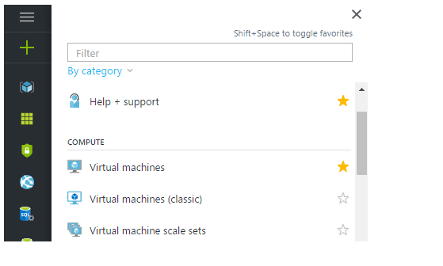
5. Favorites Menu
On the left of the portal is the favorites menu. These are icons of resource
categories (like App Services) that provide quick access. You can rearrange the
icons by dragging them up and down. You can also select which ones you want
to see when you expand the favorites menu and click on the stars of the
categories.

Slide 7
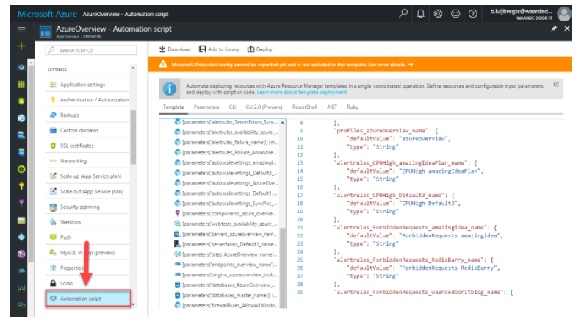
6.Automation Script
Whilst in the portal, in (almost) every resource, like a Web App, an Azure
SQL Database or a Resource Group, you have the option to generate
an automation script. You can generate an Azure Resource Manager
(ARM) Template, a Command Line Interface (CLI) script,
a PowerShell script, C# code or a Ruby script that would deploy that
particular resource through ARM. This option is very powerful if you want to
automate the deployment of your resources. It can generate scripts for most
resources with some exceptions

Slide 8
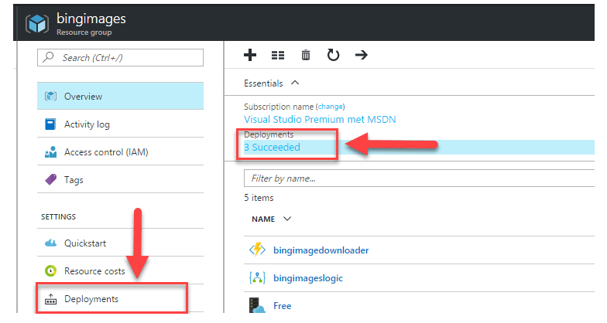
Use Azure Resource Manager features via the Azure portal.
1. Deployments to a Resource Group
We’ve seen that you can generate templates from resources, but did you know
that you can see deployments of resources to a resource group?
When you are in a resource group in the Azure portal, you can see
the deployments menu item. You can also get to the deployments from
the deployments item in the essentials blade (on the right of the image).

Slide 9
When you click it, you can see all of the deployment that happened to this resource
group and if they succeeded or failed. You can also see deployments that are in
Progress if there are any.
You can drill into a particular deployment to see details, like how long it took, and
which steps were included in the deployment. From here, you can also generate the
deployment script and even re-deploy this particular deployment.

Slide 10
Use Azure PowerShell.
What is Azure PowerShell?
Azure PowerShell is basically an extension of Windows PowerShell. It lets
Windows PowerShell users control Azure’s robust functionality. From the
command line, Azure PowerShell programmers use preset scripts called
cmdlets to perform complex tasks like provisioning virtual machines (VMs) or
creating cloud services. APS can work programmatically too, to automate
tasks. While some users complain the terminal feels “unfinished” and support
is lacking, proponents point out the ease of use aids typically intensive tasks.

Slide 11
How Azure PowerShell Works
Azure PowerShell works by using mini scripts called cmdlets to perform
powerful, common tasks in Microsoft Azure through an extension of Windows
PowerShell. Without logging in, users can enter a single cmdlet from the
command line to create a new virtual machine. Other single-cmdlet functions
include configuring a virtual machine, moving content from a local machine to
an Azure storage blog, and creating new resource groups. You can also write
scripts to automate your use of cmdlets.

